Slide 1
A (gentle) introduction to performance analysis in .NET Core 3
Or, How I learned to stop worrying and love the lldb
CHET HUSK
@CHETHUSK

Slide 2

ABOUT ME
Dog Person
Coffee Lover
That Guy on Slack that leaves an answer while out shopping then forgets to follow up
Co-Maintainer/Janitor of FSharp.Compiler.Service
Contributor to basically every F# infrastructure repo I can find
F# backend at Binary Defense (Managed Endpoint Protection)

Slide 3
Goals
Get a brief history lesson
Learn about new perf tools
See some worked examples
Feel Empowered to do perf-related work independently

Slide 4
A brief and mostly wrong Look at debugging

Slide 5

Windows
Son of Strike
WinDBG
PerfView
Notes:
On windows you have the wonderful WinDBG and PerfView, which between them let you
use the Son of Strike plugin to analyze the CLR heap
Trace callstacks/profiles to see where in your application you’re spending time

Slide 6
Son of Strike
Magic Toolbox that lets you inspect the CLR
Stacktraces
Dump Objects
View Threads

Slide 7
Debugging on Mono
gdb
pdb2mdb
lldb
AOT
MDB
perf
PDB
Notes:
Debuggers
Symbols
Compilation
GDB – GNU debugger
LLDB – LLVM Debugger
Very finicky - to get any sort of proper stacks I found I had to AOT-compile all of my binaries, which A) sometimes failed, and B) took up much more disk space
God help you if you forgot the `--debug` flag on the mono invocation of your app. No Stack Traces then
GDB foibles:
signal remapping
custom functions to remap function pointers in gdb to clr-looking function/method calls
More custom functions for stack printing
More custom functions for describing objects
LLDB –
More limited support overall
Backtraces, object printing, all provided through scripting API

Slide 8
Tracing on Mono
mono --trace
mono --profile=log
mprof-report
perf
Notes:
Mono –profile=log is powerful, but hard to consume
Problems:
* Not a structured format, so hard to analyze/diff between profile runs
No visualizations
Often broken between mono versions (profiles taken on version N weren’t readable by version N, N+1, etc)
_huge_ files. Could be trimmed down somewhat with CLI flags, but you’ve got to do that ahead of time, not interactively
Could use `perf` if you compiled your app code with `mono –aot=full` to get native binaries. Stacks tend to be inaccurate there as well, so you don’t get good pictures of where you code is actually spending time.

Slide 9
Debugging on .Net core < 3
LLDB
libsosplugin.so
createdump
Notes:
You have to follow a magic set of incantations to get a dump/debug session working on .Net Core < :
Have lldb (version 3.9ish only, mind you)
Make a dump with the create dump tool only (not your OS-specific dump utilities)
Pray you have PDBs
Now you have some limited stack traces

Slide 10
Tracing on .Net Core < 3
Perf, maybe
Environment variables: ComPLUS_PerfMapEnabled=1
Still Imperfect
PerfCollect
Crossgen
Dotnet-mapgen.py
Notes:
Even using perf you wouldn’t get complete information, so you’ve got to use perfcollect to create maps for the runtime dlls, and then collate the maps generated by the runtime and the maps from perfcollect (this is what dotnet-mapgen is for)

Slide 11

HUH?
Notes:
That’s a lot of stuff to remember to do and set up to take a dump, or analyze a dump. Surely there’s an easier way

Slide 12
dotnet-diagnostics
dotnet-dump
dotnet-trace
dotnet-sos
dotnet-counters

Slide 13
Dotnet-dump
Create dumps
Analyze dumps
$ dotnet-dump collect --process-id 1902
Writing minidump to file ./core_20190226_135837
Written 98983936 bytes (24166 pages) to core file
Complete
$ dotnet-dump analyze ./core_20190226_135850
Loading core dump: ./core_20190226_135850
Ready to process analysis commands.
Type 'help' to list available commands or 'help [command]' to get detailed help on a command.
Type 'quit' or 'exit' to exit the session.
>
Notes:
That’s all you have to do, and suddenly you’re in an actual dump inspector, with no LLDB/configuration required!

Slide 14
> help
Usage:
> [command]
Commands:
clrmodules Lists the managed modules in the process.
exit, quit Exit interactive mode.
help, soshelp <command> Display help for a command.
logging Enable/disable internal logging
lm, modules Displays the native modules in the process.
registers <threadindex> Displays the threads registers.
threads, setthread <threadindex> Sets or displays the current thread for the SOS commands.
clrstack <arguments> Provides a stack trace of managed code only.
clrthreads <arguments> List the managed threads running.
dumparray <arguments> Displays details about a managed array.
dumpasync <arguments> Displays info about async state machines on the garbage-collected heap.
dumpassembly <arguments> Displays details about an assembly.
dumpclass <arguments> Displays information about a EE class structure at the specified address.
dumpdelegate <arguments> Displays information about a delegate.
dumpdomain <arguments> Displays information all the AppDomains and all assemblies within the domains.
dumpheap <arguments> Displays info about the garbage-collected heap and collection statistics about objects.
dumpil <arguments> Displays the Microsoft intermediate language (MSIL) that is associated with a managed method.
dumplog <arguments> Writes the contents of an in-memory stress log to the specified file.
dumpmd <arguments> Displays information about a MethodDesc structure at the specified address.
dumpmodule <arguments> Displays information about a EE module structure at the specified address.
dumpmt <arguments> Displays information about a method table at the specified address.
dumpobj <arguments> Displays info about an object at the specified address.
dso, dumpstackobjects <arguments> Displays all managed objects found within the bounds of the current stack.
eeheap <arguments> Displays info about process memory consumed by internal runtime data structures.
finalizequeue <arguments> Displays all objects registered for finalization.
gcroot <arguments> Displays info about references (or roots) to an object at the specified address.
gcwhere <arguments> Displays the location in the GC heap of the argument passed in.
ip2md <arguments> Displays the MethodDesc structure at the specified address in code that has been JIT-compiled.
name2ee <arguments> Displays the MethodTable structure and EEClass structure for the specified type or method in the specified module.
pe, printexception <arguments> Displays and formats fields of any object derived from the Exception class at the specified address.
syncblk <arguments> Displays the SyncBlock holder info.
histclear <arguments> Releases any resources used by the family of Hist commands.
histinit <arguments> Initializes the SOS structures from the stress log saved in the debuggee.
histobj <arguments> Examines all stress log relocation records and displays the chain of garbage collection relocations that may have led to the address
passed in as an argument.
histobjfind <arguments> Displays all the log entries that reference an object at the specified address.
histroot <arguments> Displays information related to both promotions and relocations of the specified root.
setsymbolserver <arguments> Enables the symbol server support
Notes:
Important commands to know:
dumpobj
gcroot
Clrstack
Clrthreads
Threads
Setthread

Slide 15
dotnet-dump
lldb
Quick
No dependencies
Pretty well-equipped
More capable
Can interactively debug as well
Can read/write memory

Slide 16
Dotnet-trace
Sampling execution in a running app
root@f06197758ddd:/app# dotnet trace collect --process-id 1 --format speedscope
Press <Enter> or <Ctrl+C> to exit...
Process : /app/Profile
Output File : /app/trace.nettrace
Recording trace 657.106 (KB)
Trace completed.
Writing: /app/trace.speedscope.json
Conversion complete

Slide 17
Dotnet-trace
Formats | Providers | Viewing
Speedscope | A Whole Bunch | Speedscope NodeJs App
NetTrace |  | PerfView Windows App

Slide 18


Dotnet-sos
dotnet sos install
root@93f53eca83b9:/app# cat ~/.lldbinit
#START - ADDED BY SOS INSTALLER
plugin load /root/.dotnet/sos/libsosplugin.so
setsymbolserver -ms
#END - ADDED BY SOS INSTALLER
This alone justifies the upgrade to .Net Core 3.0

Slide 19
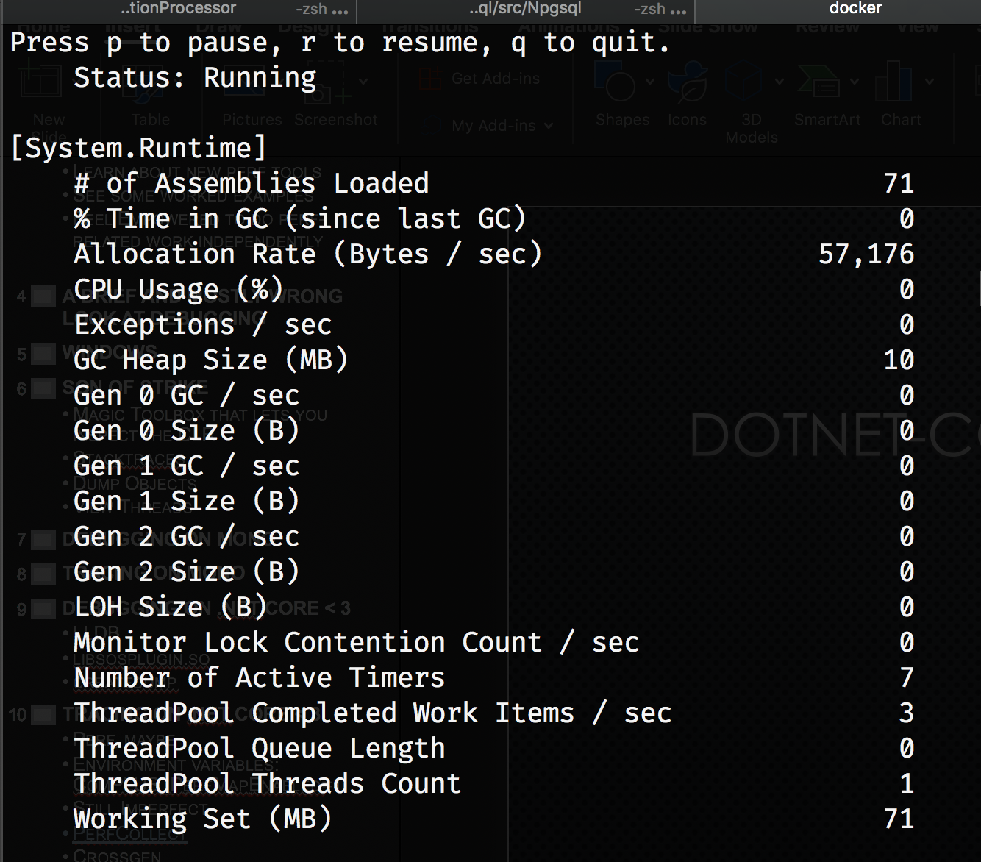
Dotnet-counters
CLI Viewer for built-in metrics
Periodic Updates
Counters are push-based (not pull)
High-performance
Look to github for prometheus exporters
Notes:
The key point of the counters here are to show that you can use things that’s don’t have the fragility of ETW in a performant way, and use a single exporter component (which could even be out of process!) to collect and export your counters.
This is good for eg sidecar deployments in k8s…

Slide 20

Whew
Notes:
Congrats, we made it through the data-dump portion of the talk

Slide 21
Scenario 1
Memory Leak

Slide 22
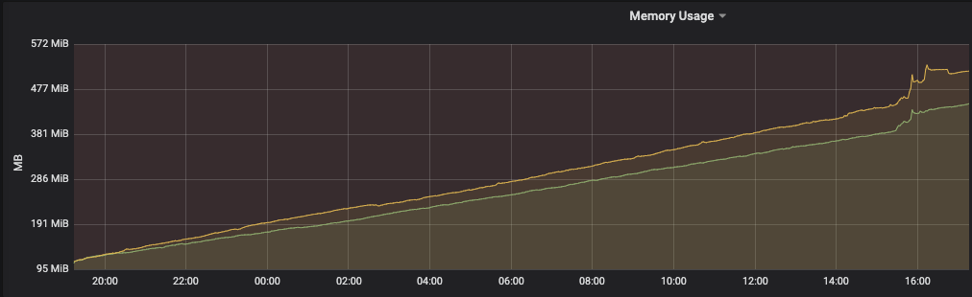
The Problem

Slide 23
Investigation
Take a dump of production machine
dotnet dump analyze

Slide 24
> dotnet dump analyze /path/to/dump
> dumpheap -min 10000
...
Address MT Size
...
00007fd498007cd0 00007fd4ded5cd20 174092
...
Statistics:
MT Count TotalSize Class Name
...
00007fd4ded5cd20 <some_num> <total> System.String
...
Total <some_num> objects

Slide 25
> dumpobj 00007fd498007cd0
Name: System.String
MethodTable: 00007fd4ded5cd20
EEClass: 00007fd4de4c9c20
Size: 174092(0x2a80c) bytes
File: /app/System.Private.CoreLib.dll
String:
Fields:
MT Field Offset Type VT Attr Value Name
00007fd4ded5f660 40001b1 8 System.Int32 1 instance 87033 _stringLength
00007fd4ded5f218 40001b2 c System.Char 1 instance 3c _firstChar
00007fd4ded5cd20 40001b3 58 System.String 0 shared static Empty

Slide 26
But how do we read that string?

Slide 27
> dotnet symbols <path to core dump>
> lldb --core <path to core dump> <path to App>
> memory read 00007fd498007cd0+c -c 1000 --force --format Y
…
<instrumentationManifest xmlns="http://schemas.microsoft.com/win/2004/08/events".>
<instrumentation xmlns:xs="http://www.w3.org/2001/XMLSchema"
xmlns:xsi="http://www.w3.org/2001/XMLSchema-instance"
xmlns:win="http://manifests.microsoft.com/win/2004/08/windows/events">
<events xmlns="ht
…

Slide 28
Resolution
Turns out that there was a bug in the ETW system in .Net core 2.2: https://github.com/dotnet/coreclr/issues/26344
Short resolution: disable Runtime ETW events
Fixed in .Net Core 3.0, so monitoring can begin again!

Slide 29
Scenario 2
CPU Profile

Slide 30
The Problem
Method | ArrayLength | Mean | Error | StdDev | Gen 0 | Gen 1 | Gen 2 | Allocated
Newtonsoft | 1 | 2.309 us | 0.3416 us | 0.0187 us | 0.5341 | - | - | 2240 B
SystemTextJson | 1 | 3.093 us | 0.2150 us | 0.0118 us | 0.1640 | - | - | 688 B
Newtonsoft | 10 | 17.766 us | 6.4282 us | 0.3524 us | 1.9836 | - | - | 8328 B
SystemTextJson | 10 | 25.582 us | 7.5592 us | 0.4143 us | 1.1902 | - | - | 5024 B
Newtonsoft | 100 | 171.889 us | 96.7675 us | 5.3042 us | 19.7754 | 0.2441 | - | 83048 B
SystemTextJson | 100 | 253.261 us | 19.8938 us | 1.0904 us | 11.2305 | - | - | 48400 B
Newtonsoft | 1000 | 1,784.456 us | 86.2631 us | 4.7284 us | 121.0938 | 58.5938 | 58.5938 | 684768 B
SystemTextJson | 1000 | 2,598.975 us | 113.6843 us | 6.2314 us | 117.1875 | 58.5938 | 58.5938 | 495709 B
(De)serializing F# Types with System.Text.Json is slow
~60% slower
Fewer allocations don’t balance run-time cost

Slide 31
Investigation
Profile the app
view a flame graph of hotspots
Improve algorithm

Slide 32
Profile the App
dotnet trace collect –process-id $PID –format speedscope
speedscope path/to/file

Slide 33
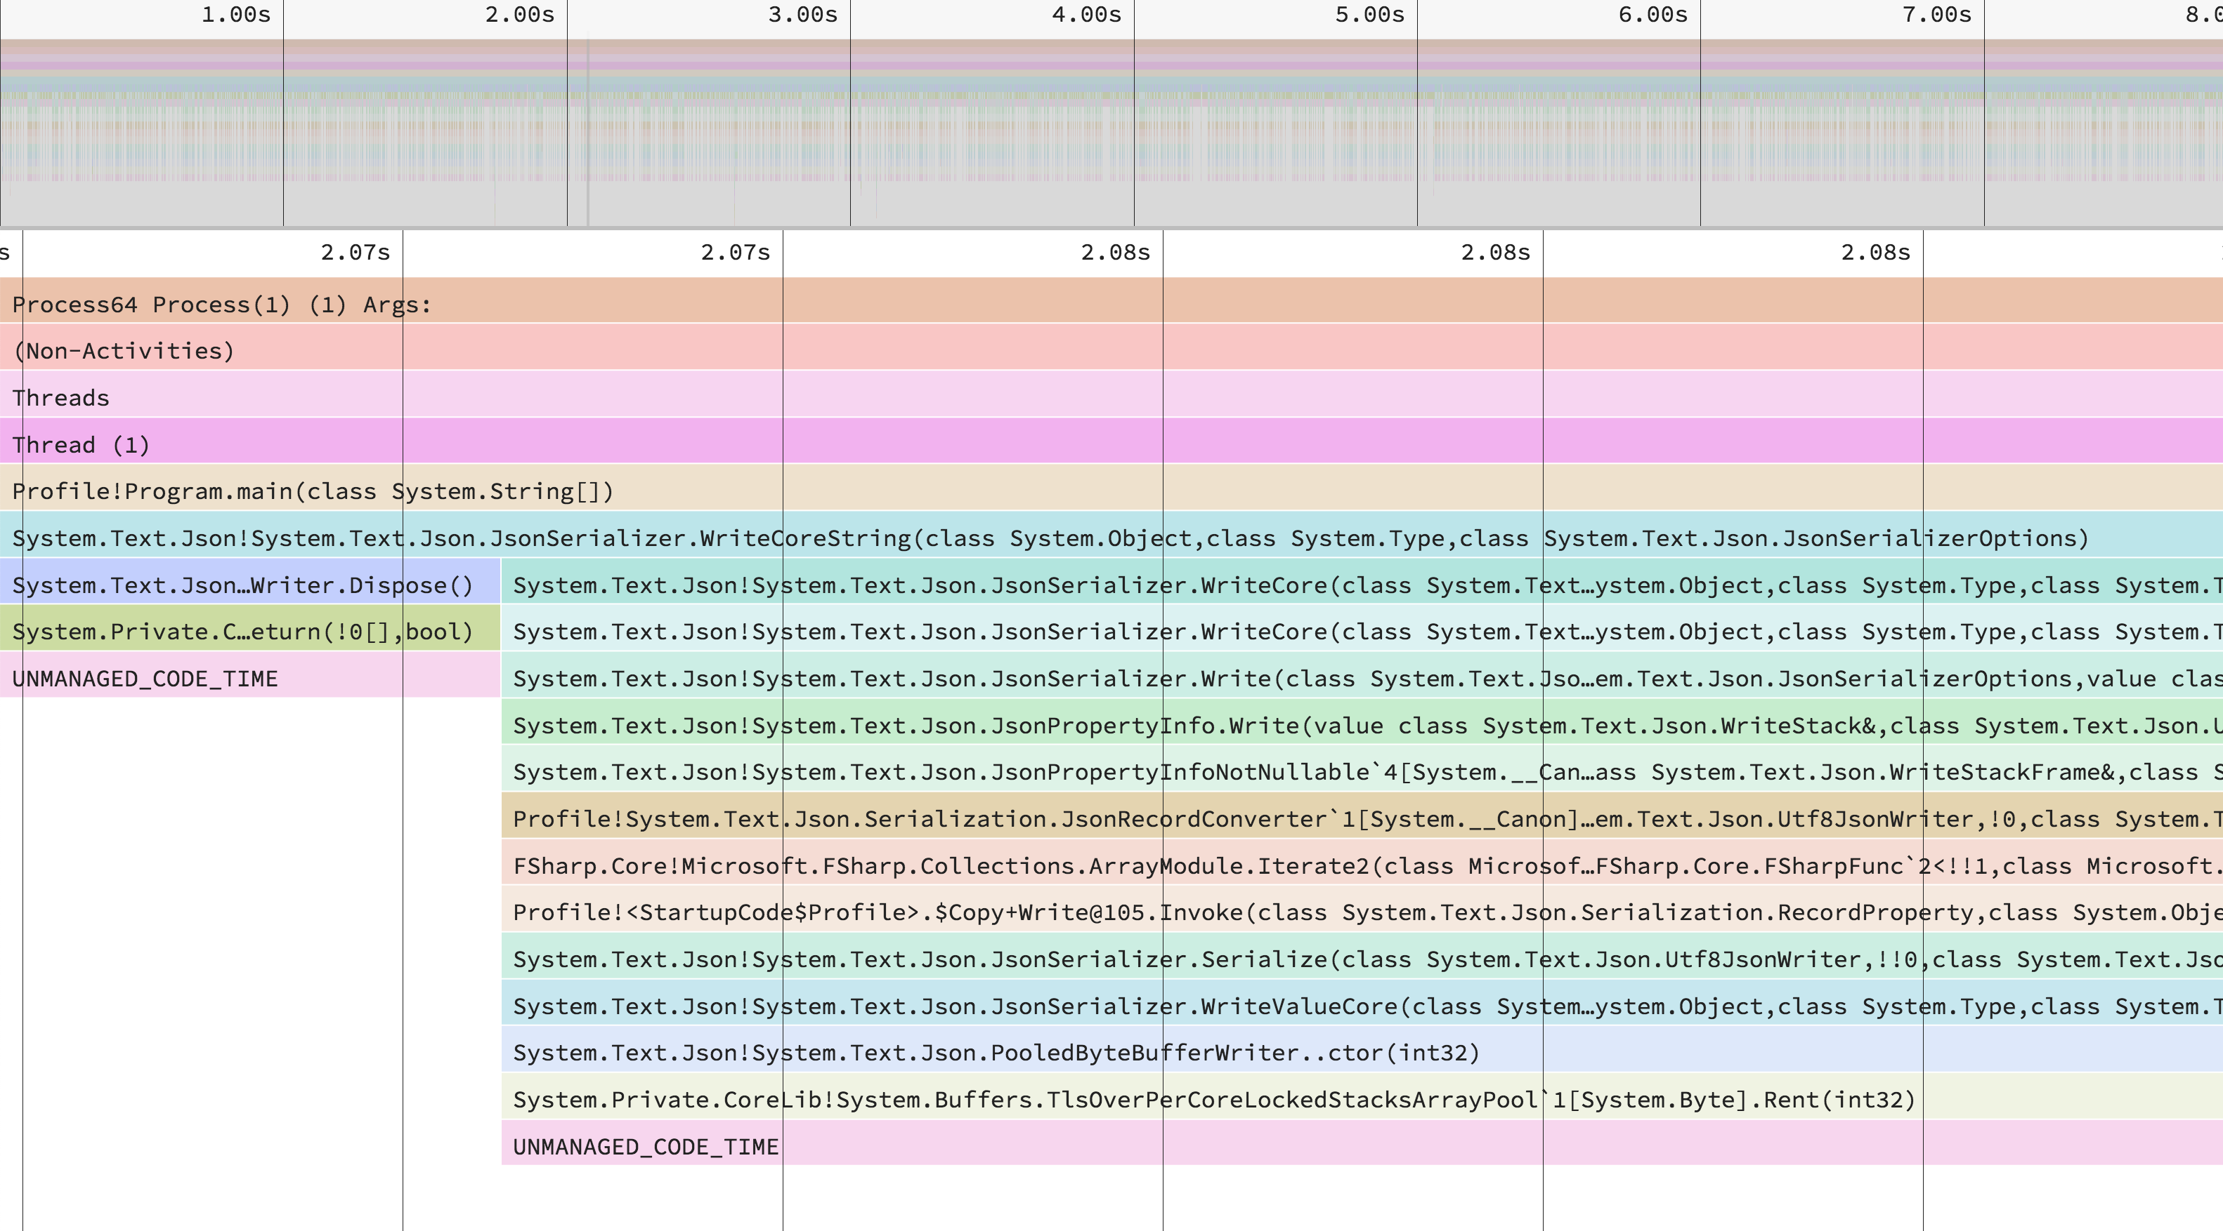

Slide 34
Prior Algorithm
override __.Write(writer, value, options) =
writer.WriteStartObject()
(fieldProps, dector value)
||> Array.iter2 (fun p v ->
if not p.Ignore then
writer.WritePropertyName(p.Name)
JsonSerializer.Serialize(writer, v, options))
writer.WriteEndObject()
Very reflection heavy
Lots of property boxing (allocations)

Slide 35
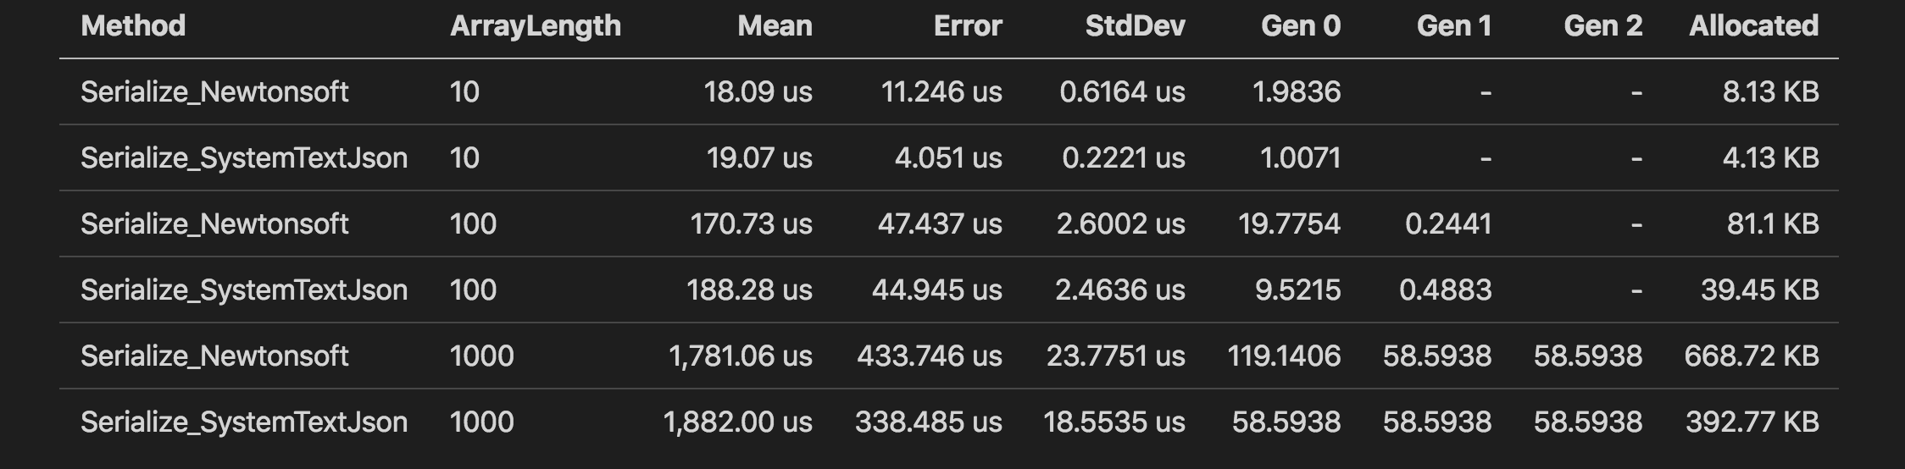
New Algorithm
https://github.com/Tarmil/FSharp.SystemTextJson/pull/15
Still slightly slower, but now with massively fewer allocations as a result

Slide 36
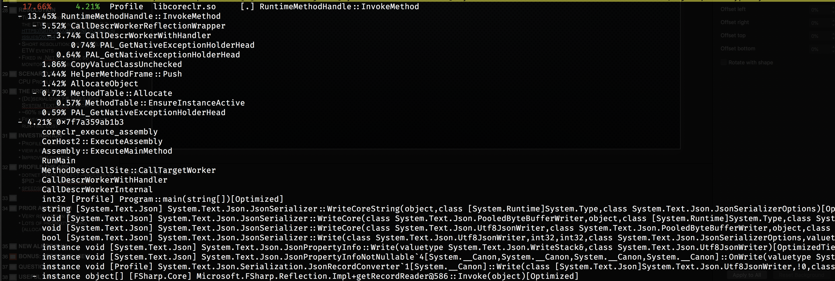
BONUS: Perf tool View

Slide 37
Questions?

Slide 38
Useful Links
https://github.com/dotnet/diagnostics
https://github.com/jlfwong/speedscope
https://perf.wiki.kernel.org/index.php/Main_Page
https://github.com/brendangregg/FlameGraph/blob/master/flamegraph.pl
In the future: Causal Profiling?

Slide 39

Thank you!

